Slide 1

Health+
Team: BCM-UP
Team Members: Low Xuan Wei (2301949) Rachelle Tan Wen Qi (2302259) Deric Allen Bautista Mayores (2302057) Kan Hiew Teng (2302193) Chan Jun Xiang Jordan (2302141)

Slide 2
TABLE OF CONTENTS
o1
04
02
05
03
Background
Features
Problem Statement
Conclusion
Solution

Slide 3
Background

Slide 4
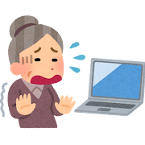
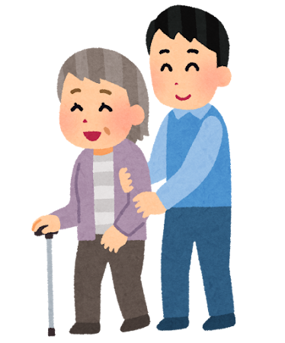
Background
Growing aging population
Need to ensure adequate care for the elderly
Highlight increasing importance of technological solutions
‌

Slide 5
Problem Statement

Slide 6
Problem Statement
How might we create a mobile application that provides a platform that prioritizes user accessibility and simplicity, especially for elderly individuals and their caregivers, offering features that provide clear and concise information and easy access to healthcare services?

Slide 7
Solution

Slide 8
Health+
Develop an integrated application for healthcare services
Real-time health metrics services
Dependency management services
Booking consultation services
Communication healthcare related services
Inspired by HealthHub SG
Targeted at Caregivers to help manage healthcare services for elderly/dependencies
‌

Slide 9
Features

Slide 10
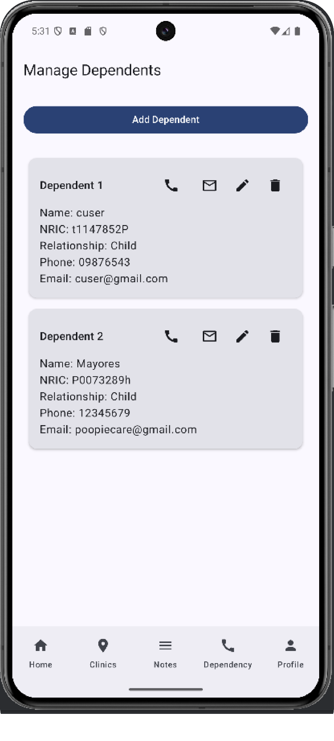
Manage Dependents
View information of the caregiver & user
Caregiver
Max 3 dependents
Manage dependents
Contact
‌
‌
Notes:
Talk about create, update, delete
Validation for Caregivers → Limiting to 3 dependencies per caregiver, since realistically there is only so much a caregiver can take care of
Validation for normal user → Do not allow user to manage their caregiver, only shows message and call feature based on user role

Slide 11
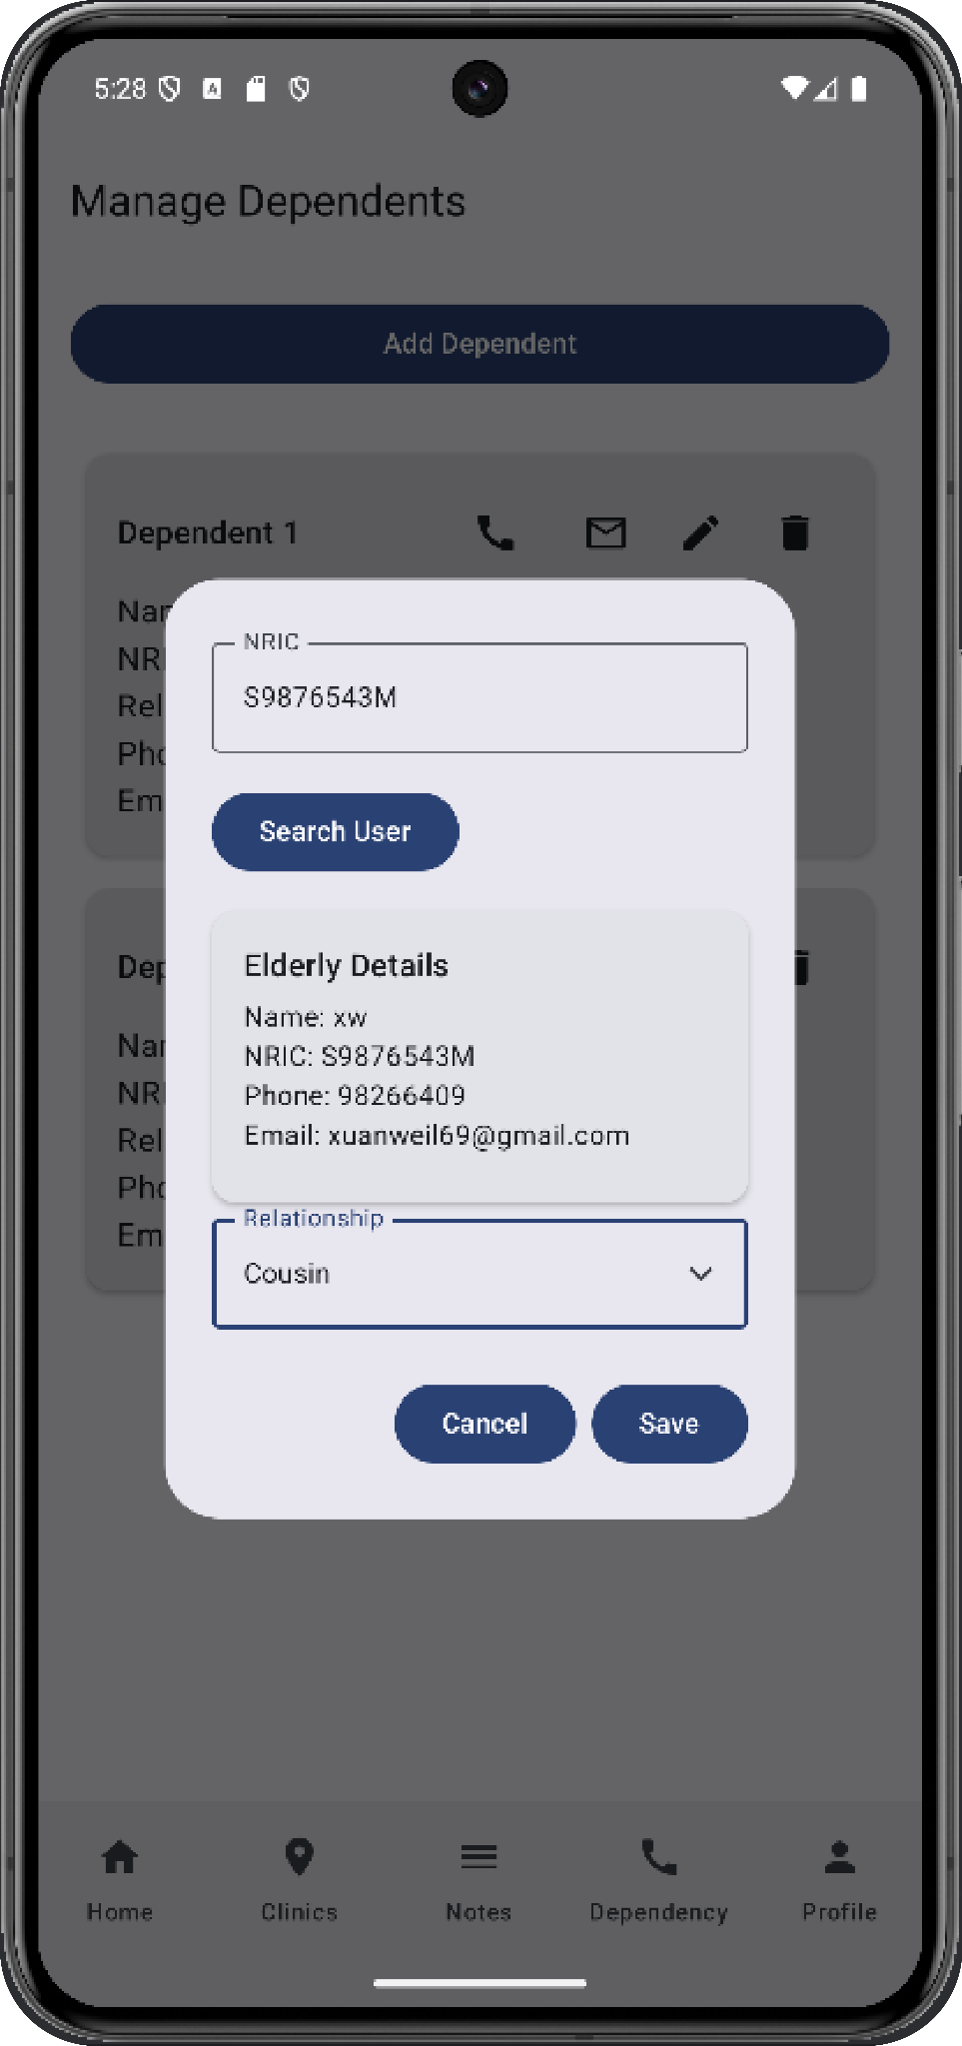
Manage Dependents
View information of the caregiver & user
Caregiver
Max 3 dependents
Manage dependents
Contact
‌
‌
Notes:
Talk about create, update, delete
Validation for Caregivers → Limiting to 3 dependencies per caregiver, since realistically there is only so much a caregiver can take care of
Validation for normal user → Do not allow user to manage their caregiver, only shows message and call feature based on user role

Slide 12
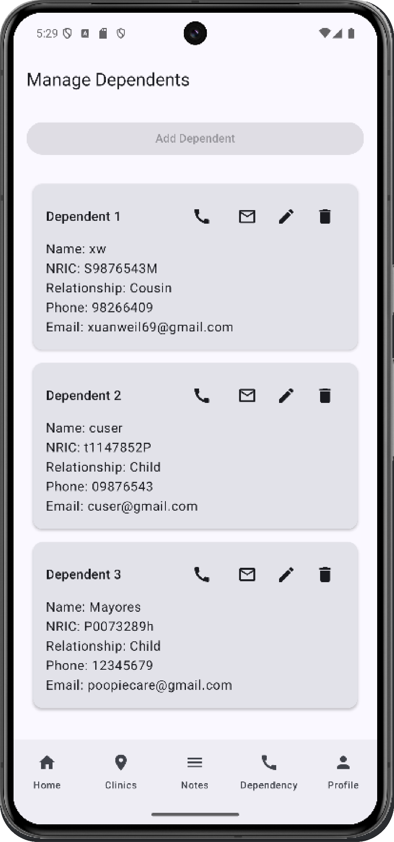
Manage Dependents
View information of the caregiver & user
Caregiver
Max 3 dependents
Manage dependents
Contact
‌
‌
Notes:
Talk about create, update, delete
Validation for Caregivers → Limiting to 3 dependencies per caregiver, since realistically there is only so much a caregiver can take care of
Validation for normal user → Do not allow user to manage their caregiver, only shows message and call feature based on user role

Slide 13
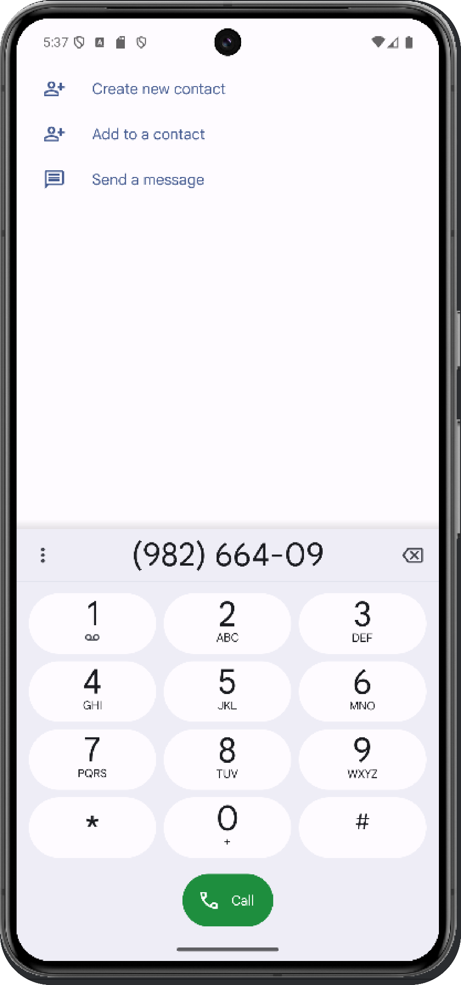
Manage Dependents
View information of the caregiver & user
Caregiver
Max 3 dependents
Manage dependents
Contact
‌
‌
Notes:
Talk about create, update, delete
Validation for Caregivers → Limiting to 3 dependencies per caregiver, since realistically there is only so much a caregiver can take care of
Validation for normal user → Do not allow user to manage their caregiver, only shows message and call feature based on user role

Slide 14
Manage Dependents
View information of the caregiver & user
Caregiver
Max 3 dependents
Manage dependents
Contact
‌
‌
Notes:
Talk about create, update, delete
Validation for Caregivers → Limiting to 3 dependencies per caregiver, since realistically there is only so much a caregiver can take care of
Validation for normal user → Do not allow user to manage their caregiver, only shows message and call feature based on user role

Slide 15
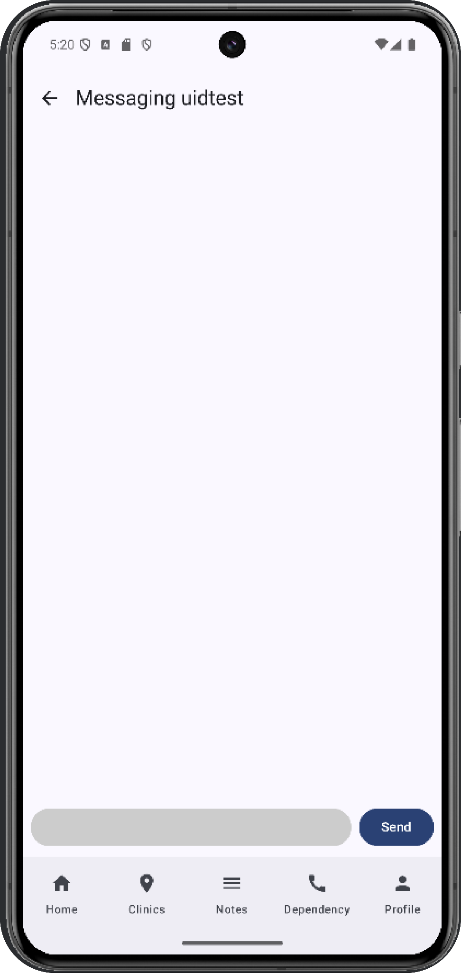
Manage Dependents
View information of the caregiver & user
Caregiver
Max 3 dependents
Manage dependents
Contact
‌
‌
Notes:
Talk about create, update, delete
Validation for Caregivers → Limiting to 3 dependencies per caregiver, since realistically there is only so much a caregiver can take care of
Validation for normal user → Do not allow user to manage their caregiver, only shows message and call feature based on user role

Slide 16
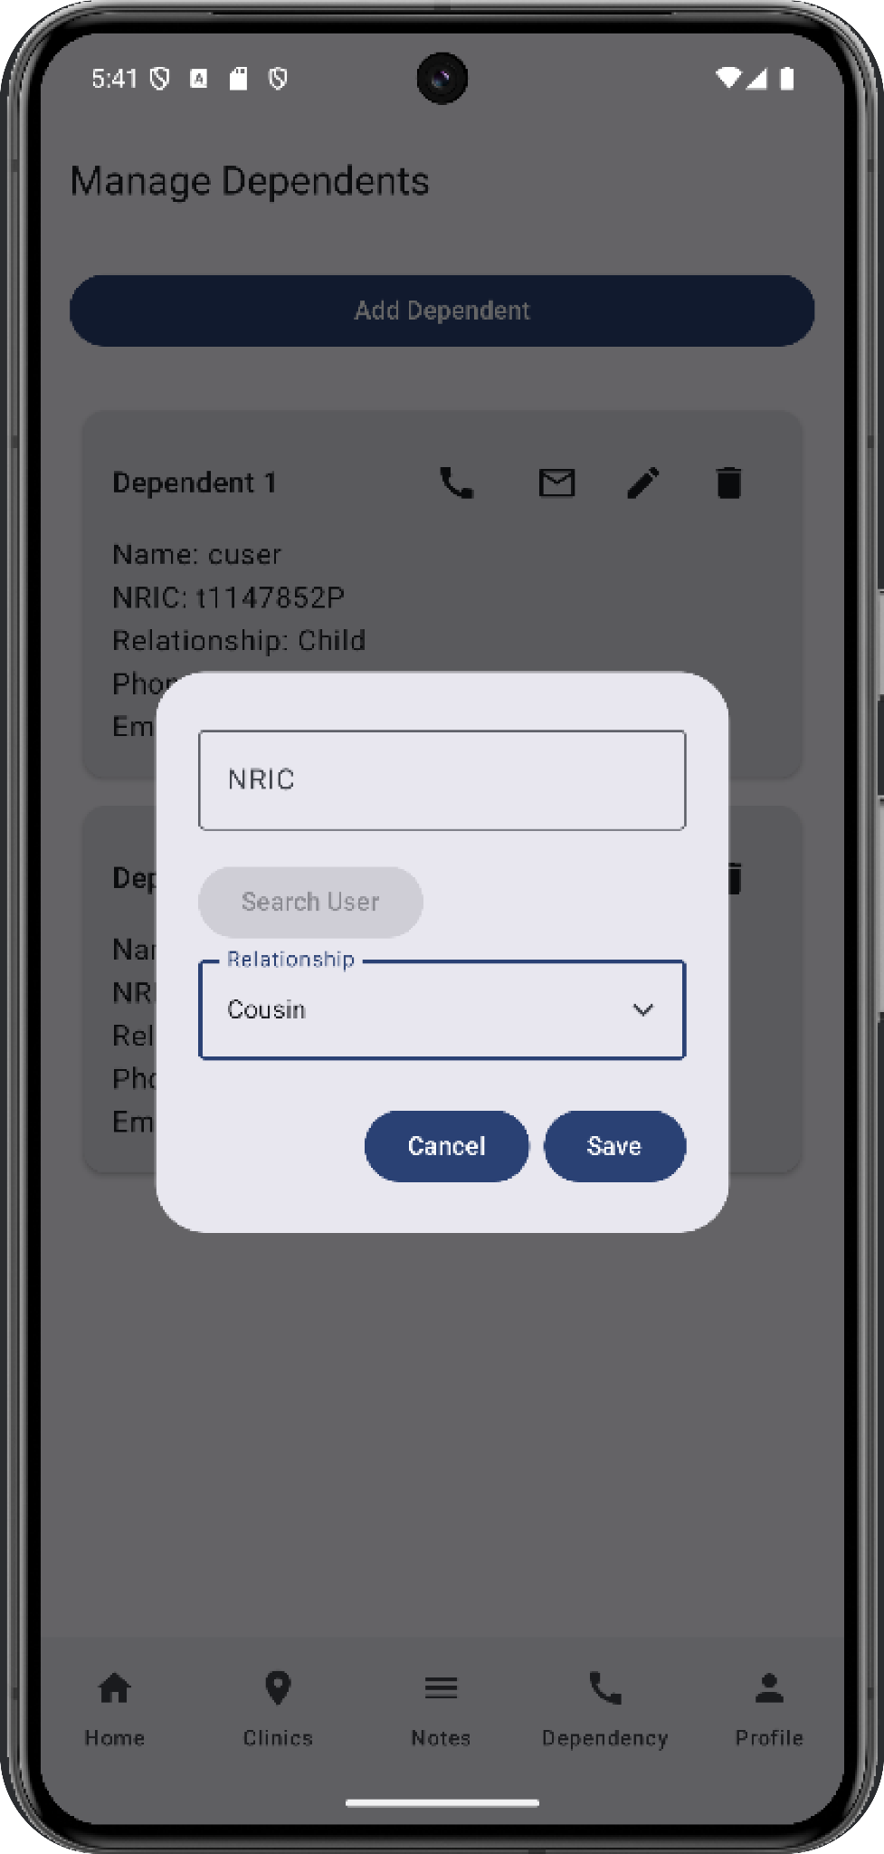
Manage Dependents
View information of the caregiver & user
Caregiver
Max 3 dependents
Manage dependents
Contact
‌
‌
Notes:
Talk about create, update, delete
Validation for Caregivers → Limiting to 3 dependencies per caregiver, since realistically there is only so much a caregiver can take care of
Validation for normal user → Do not allow user to manage their caregiver, only shows message and call feature based on user role

Slide 17
Manage Dependents
View information of the caregiver & user
Caregiver
Max 3 dependents
Manage dependents
Contact
‌
‌
Notes:
Talk about create, update, delete
Validation for Caregivers → Limiting to 3 dependencies per caregiver, since realistically there is only so much a caregiver can take care of
Validation for normal user → Do not allow user to manage their caregiver, only shows message and call feature based on user role

Slide 18
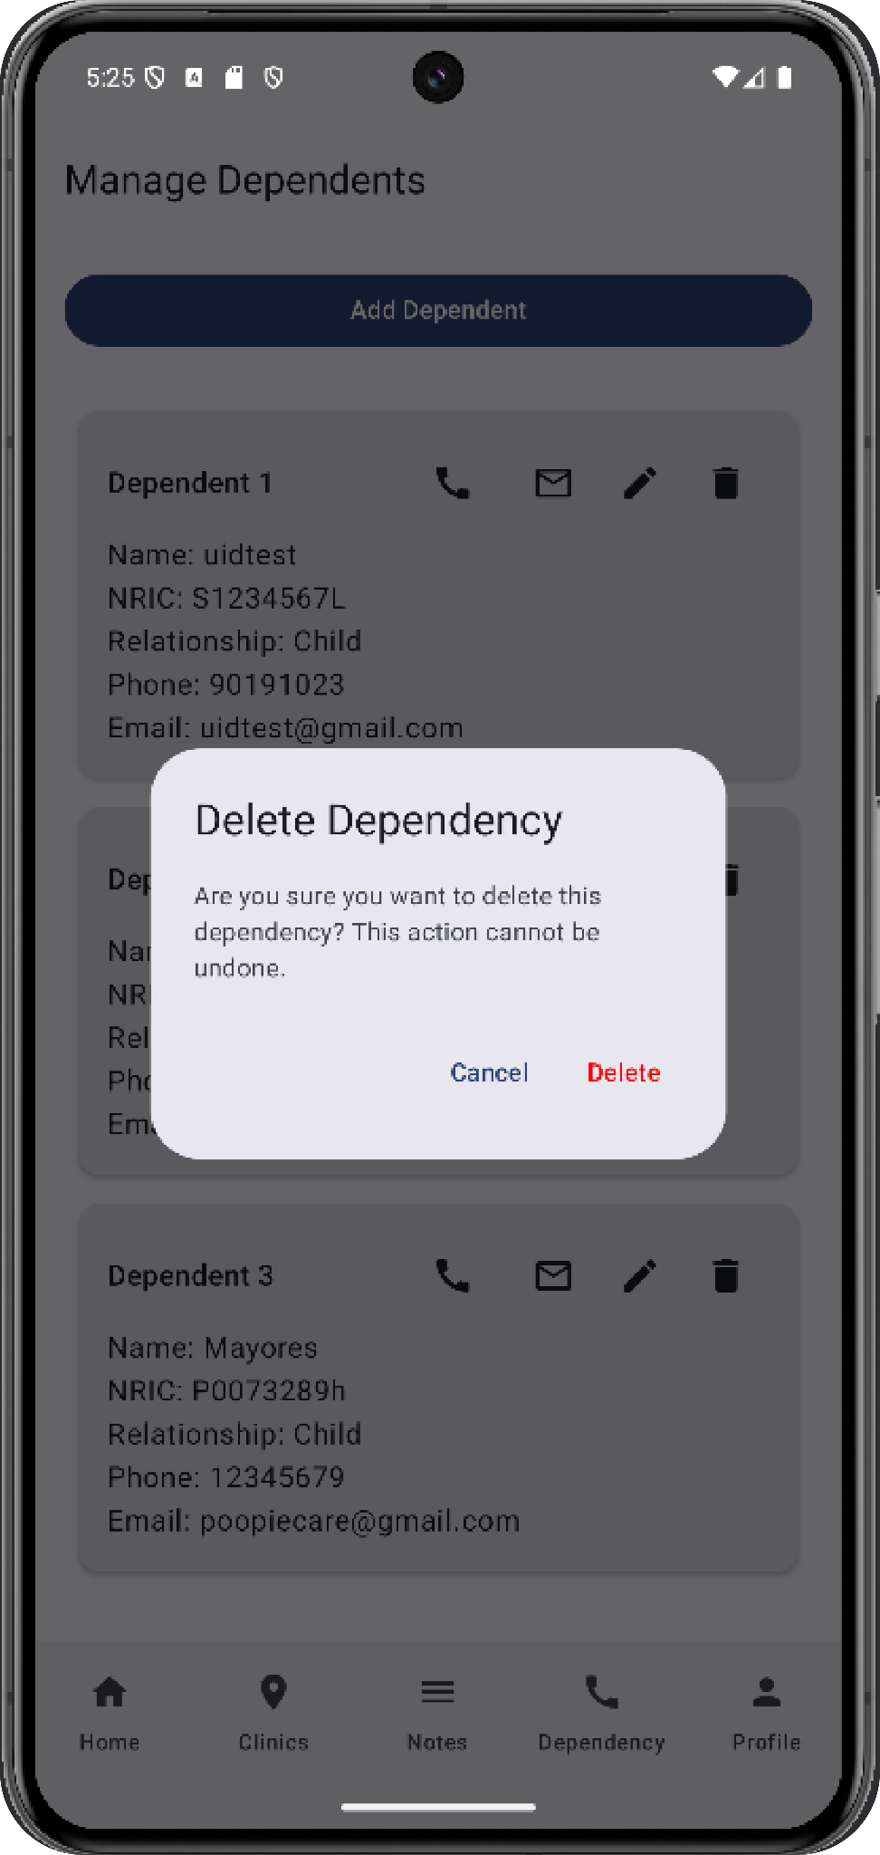
Manage Dependents
View information of the caregiver & user
Caregiver
Max 3 dependents
Manage dependents
Contact
‌
‌
Notes:
Talk about create, update, delete
Validation for Caregivers → Limiting to 3 dependencies per caregiver, since realistically there is only so much a caregiver can take care of
Validation for normal user → Do not allow user to manage their caregiver, only shows message and call feature based on user role

Slide 19
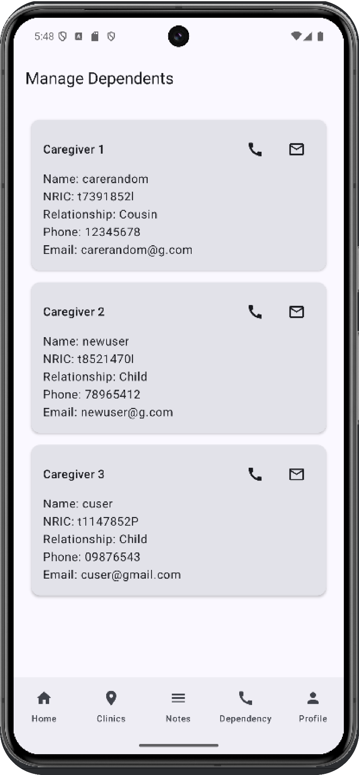
Manage Dependents
View information of the caregiver & user
Caregiver
Max 3 dependents
Manage dependents
Contact
‌
‌
Notes:
Talk about create, update, delete
Validation for Caregivers → Limiting to 3 dependencies per caregiver, since realistically there is only so much a caregiver can take care of
Validation for normal user → Do not allow user to manage their caregiver, only shows message and call feature based on user role

Slide 20
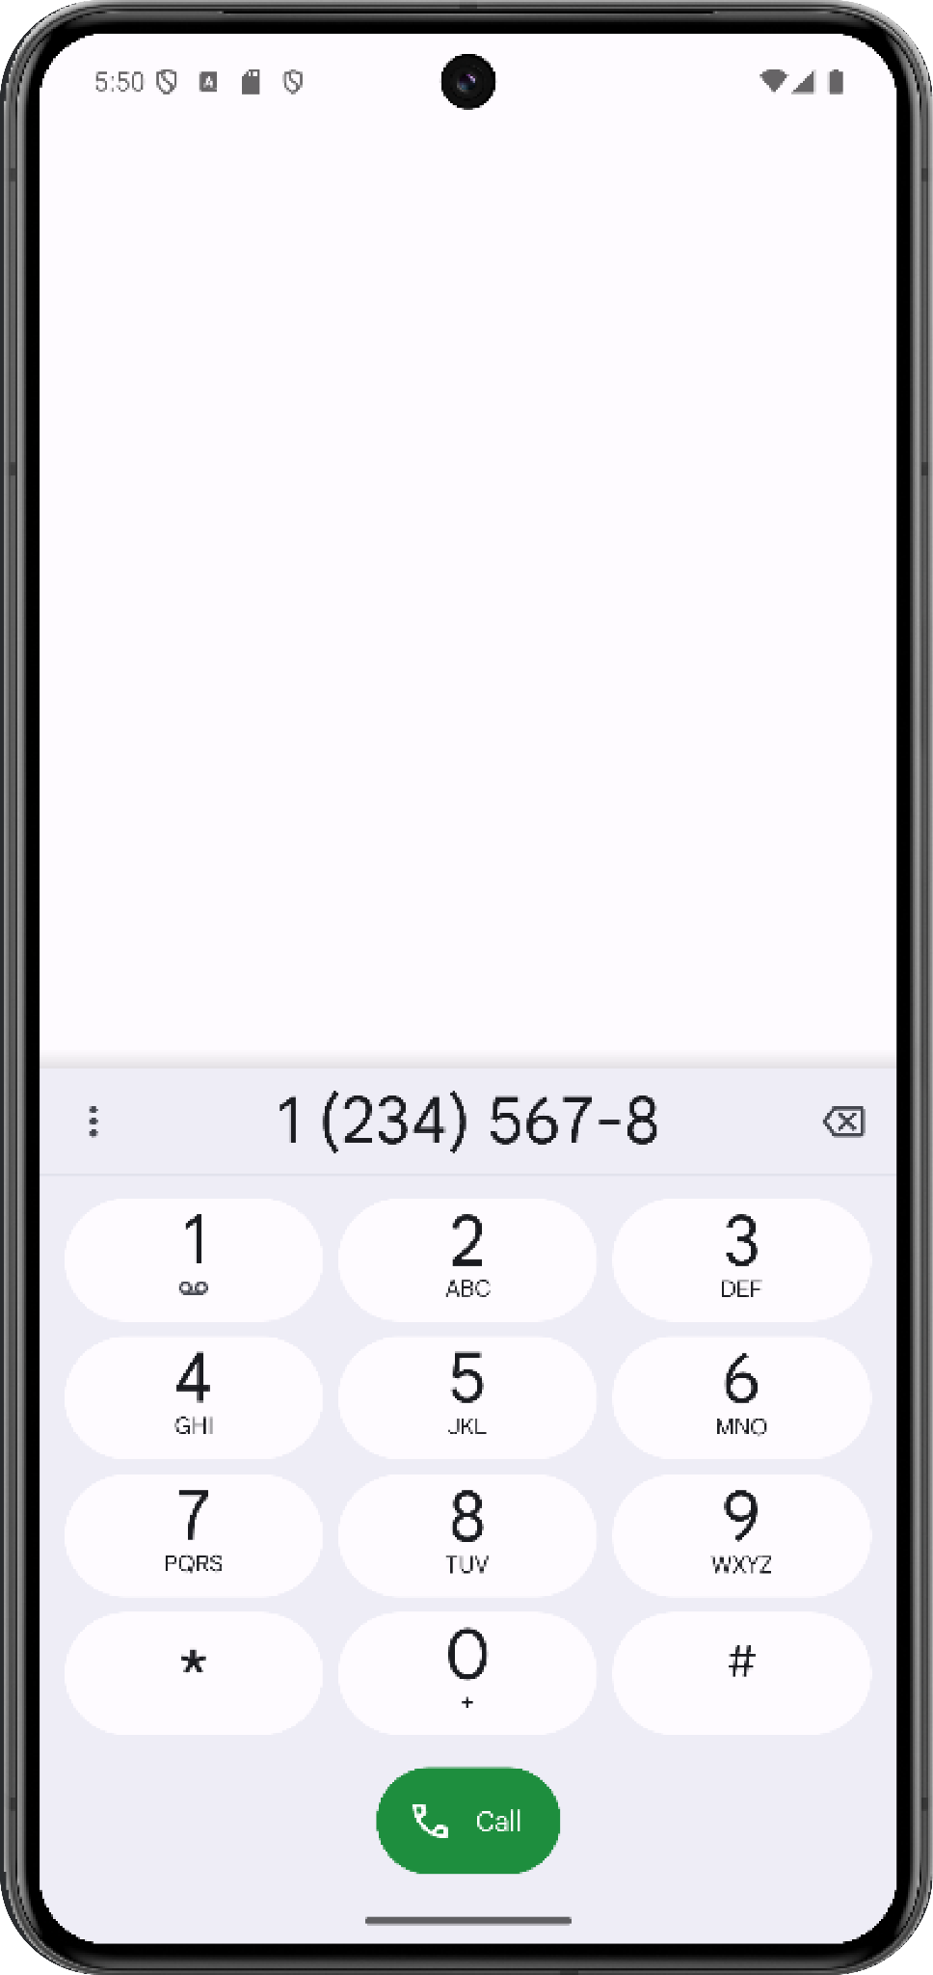
Manage Dependents
View information of the caregiver & user
Caregiver
Max 3 dependents
Manage dependents
Contact
‌
‌
Notes:
Talk about create, update, delete
Validation for Caregivers → Limiting to 3 dependencies per caregiver, since realistically there is only so much a caregiver can take care of
Validation for normal user → Do not allow user to manage their caregiver, only shows message and call feature based on user role

Slide 21
User

Slide 22
Manage Dependents
View information of the caregiver & user
User
Not allowed to manage caregivers
Contact (Text & Call)
‌
‌
Notes:
Talk about create, update, delete
Validation for Caregivers → Limiting to 3 dependencies per caregiver, since realistically there is only so much a caregiver can take care of
Validation for normal user → Do not allow user to manage their caregiver, only shows message and call feature based on user role

Slide 23

Manage Dependents
View information of the caregiver & user
User
Not allowed to manage caregivers
Contact (Text & Call)
‌
‌
Notes:
Talk about create, update, delete
Validation for Caregivers → Limiting to 3 dependencies per caregiver, since realistically there is only so much a caregiver can take care of
Validation for normal user → Do not allow user to manage their caregiver, only shows message and call feature based on user role

Slide 24
Manage Dependents
View information of the caregiver & user
User
Not allowed to manage caregivers
Contact (Text & Call)
‌
‌
Notes:
Talk about create, update, delete
Validation for Caregivers → Limiting to 3 dependencies per caregiver, since realistically there is only so much a caregiver can take care of
Validation for normal user → Do not allow user to manage their caregiver, only shows message and call feature based on user role

Slide 25
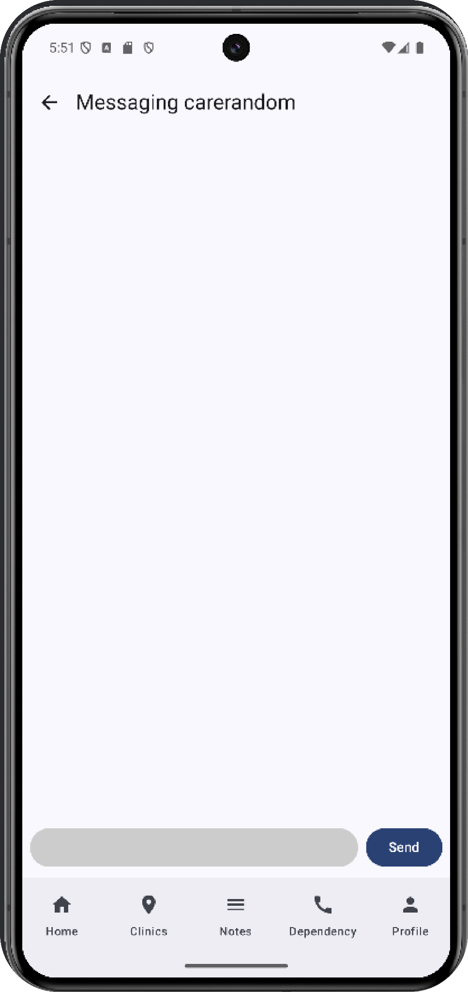
Manage Dependents
View information of the caregiver & user
User
Not allowed to manage caregivers
Contact (Text & Call)
‌
‌
Notes:
Talk about create, update, delete
Validation for Caregivers → Limiting to 3 dependencies per caregiver, since realistically there is only so much a caregiver can take care of
Validation for normal user → Do not allow user to manage their caregiver, only shows message and call feature based on user role

Slide 26
Manage Dependents
View information of the caregiver & user
Caregiver
Max 3 dependents
Manage dependents
User
Not allowed to manage caregivers
Contact (Text & Call)
‌
‌
Notes:
Talk about create, update, delete
Validation for Caregivers → Limiting to 3 dependencies per caregiver, since realistically there is only so much a caregiver can take care of
Validation for normal user → Do not allow user to manage their caregiver, only shows message and call feature based on user role

Slide 27
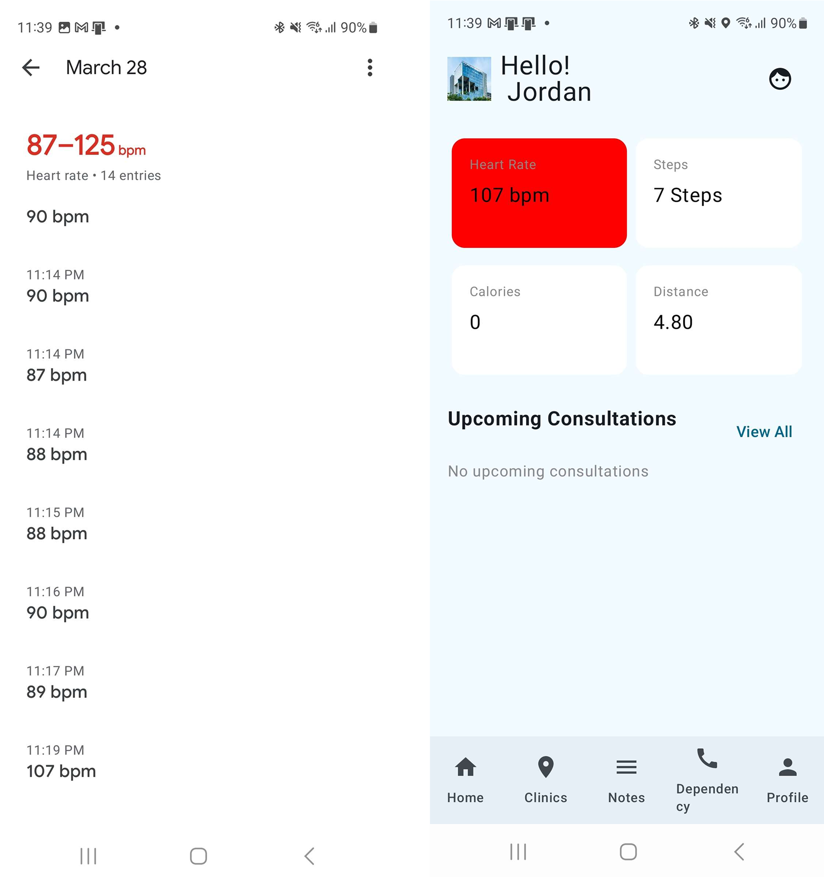
Vitals Monitoring
Retrieve vitals information from the sensor on wearable devices that are connected to Google Health Connect
Values that reach unhealthy levels will be highlighted in red to warn users
Allows caregivers and patient to self monitor their vitals on the go at all times

Slide 28
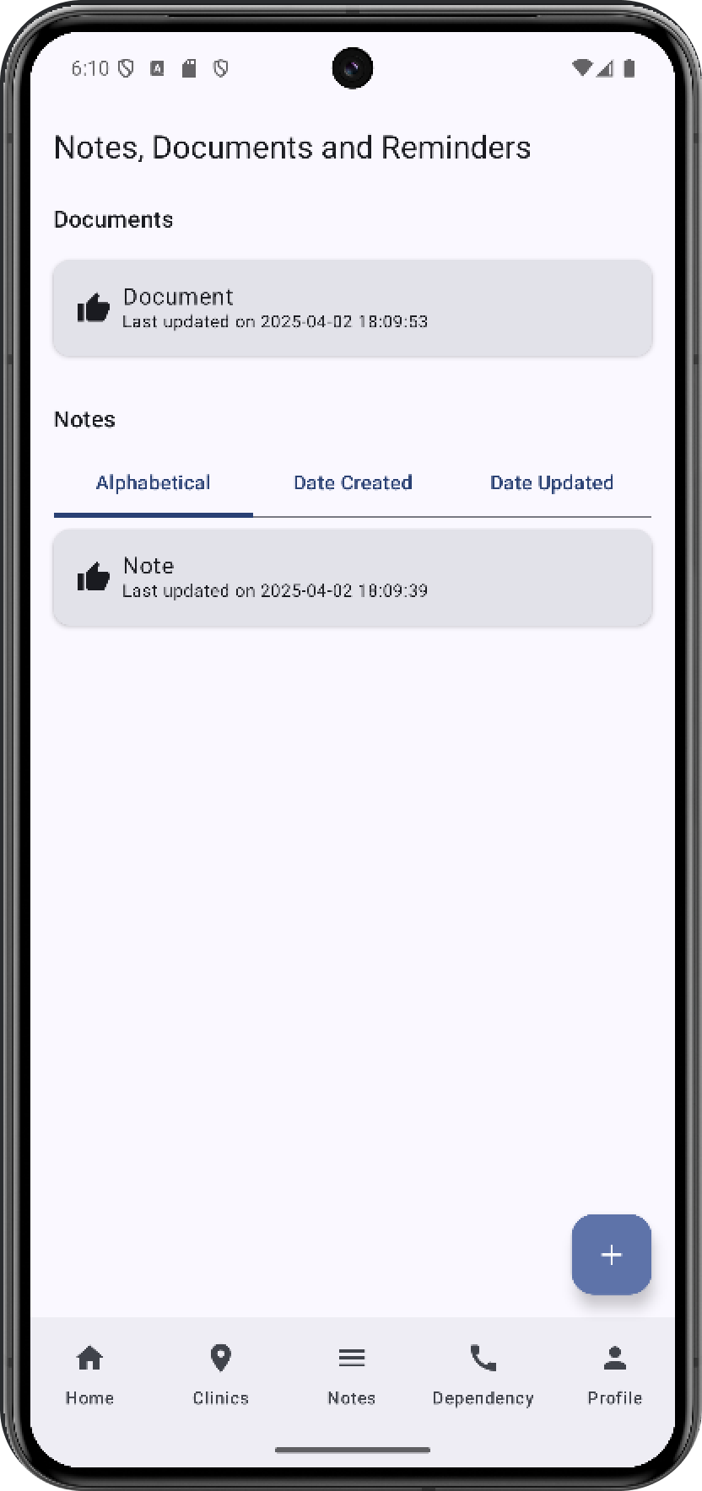
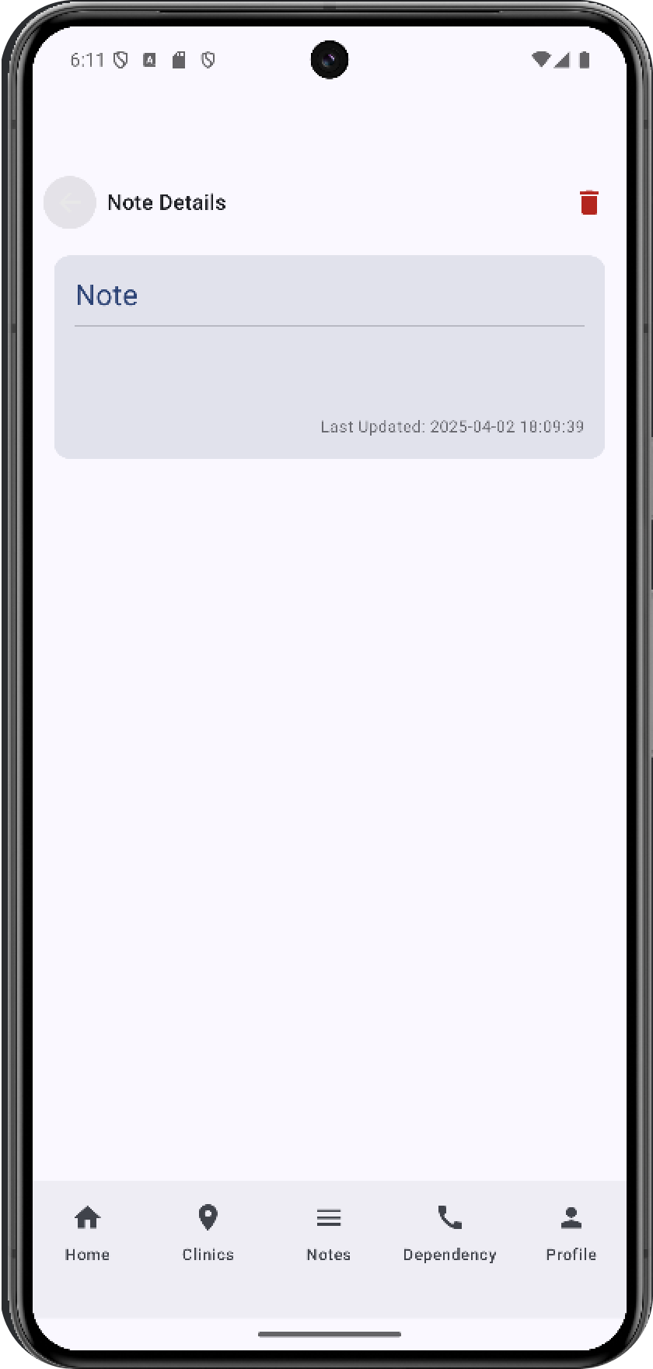
Notes and Documents
Allow users and caretakers to store medical documents and notes/reminders in an accessible platform
Provides an easy to access location for storage of documents and notes, which can help patients with memory related illnesses

Slide 29
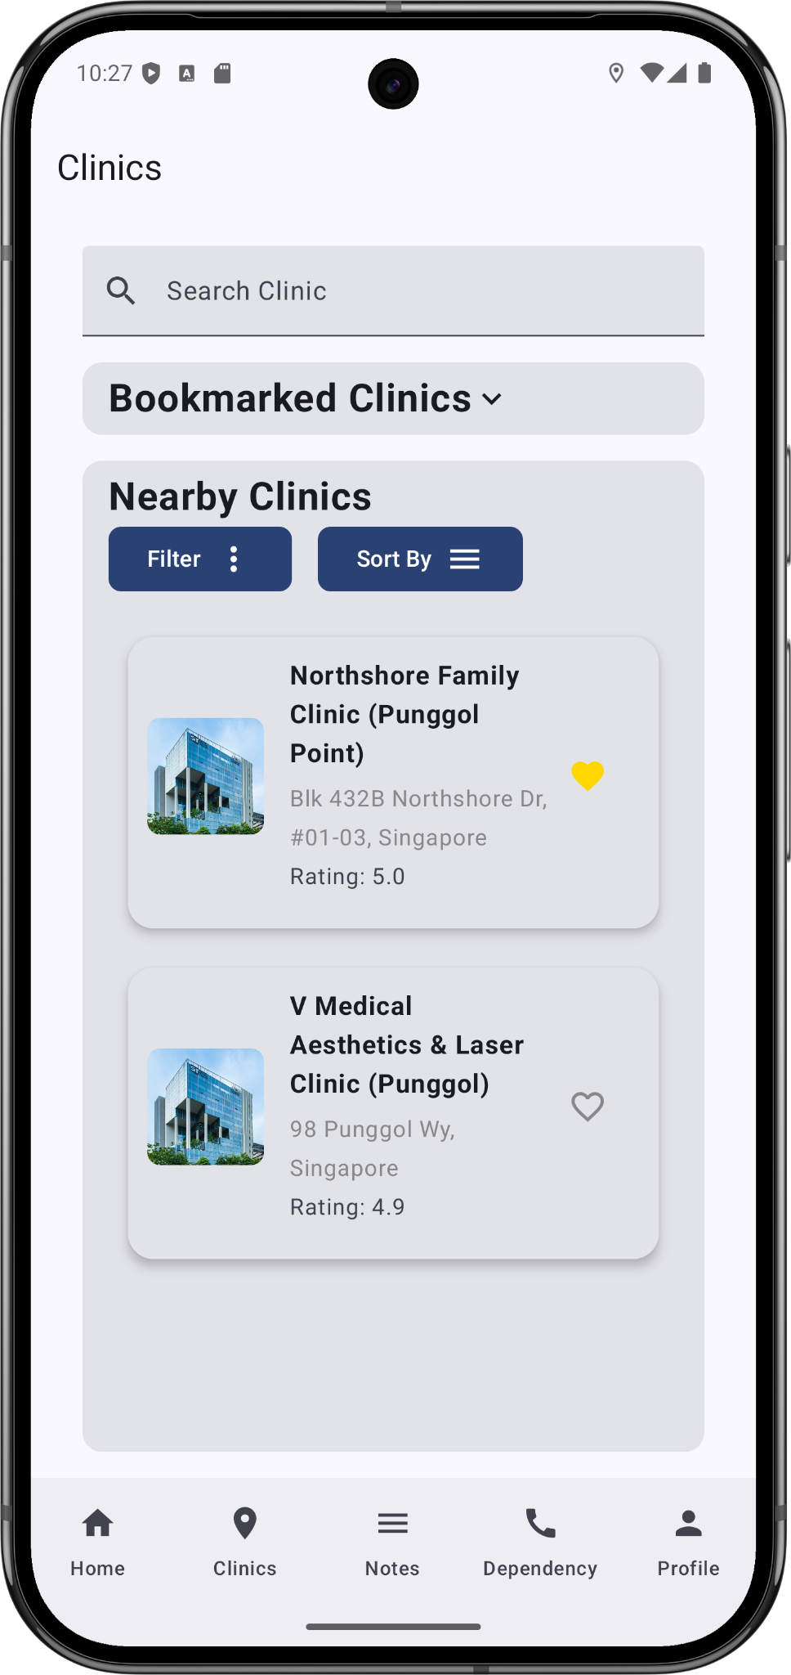
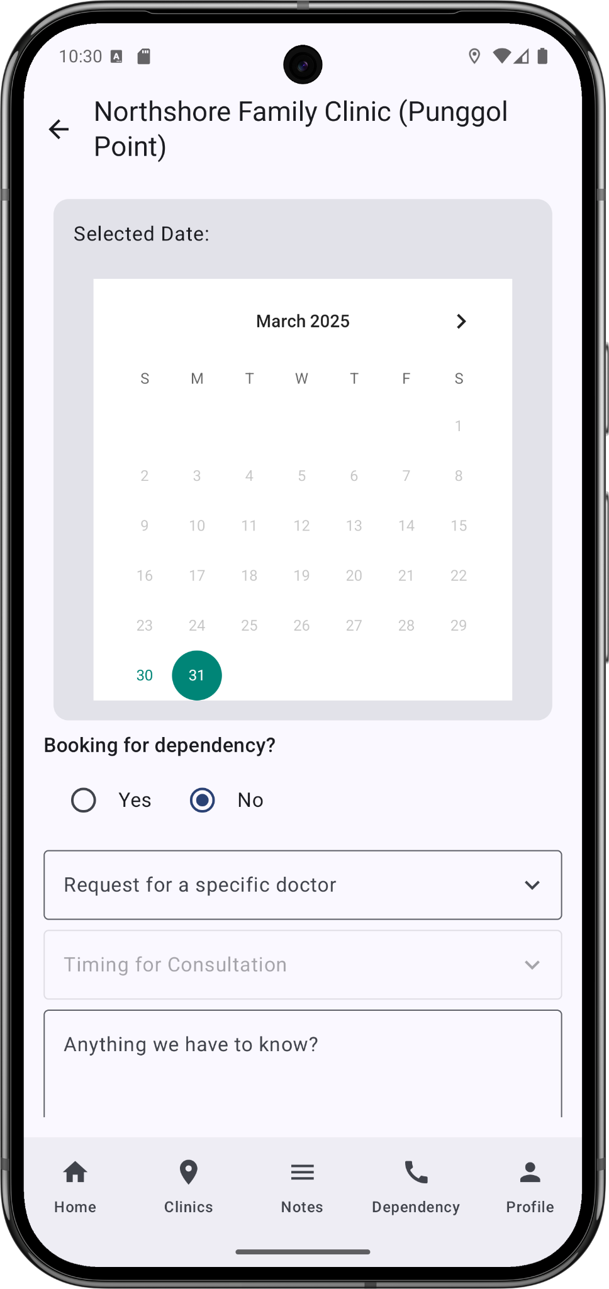
Clinic Details + Consultation Booking
Locate Nearby Clinics (Google Maps API)
Displays: Name, Address, Ratings
Radius Range: 500m, 1000m, 1500m
Consultations
Walk-in consultations
Appointment consultations
Dependency
Caregiver
Bookmarks
Save frequented/preferred clinics
Filtering/Sorting
Efficient searches
‌

Slide 30
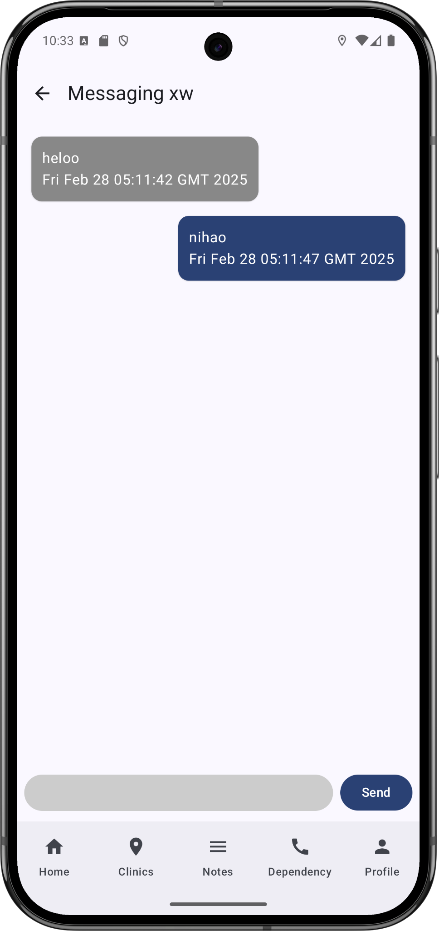
Message + Call Integration
Allows seamless messaging between caregiver and dependency
Allows user to easily contact each other through Call Integration
Provide communication medium for caregiver and dependency in integrated application
‌

Slide 31
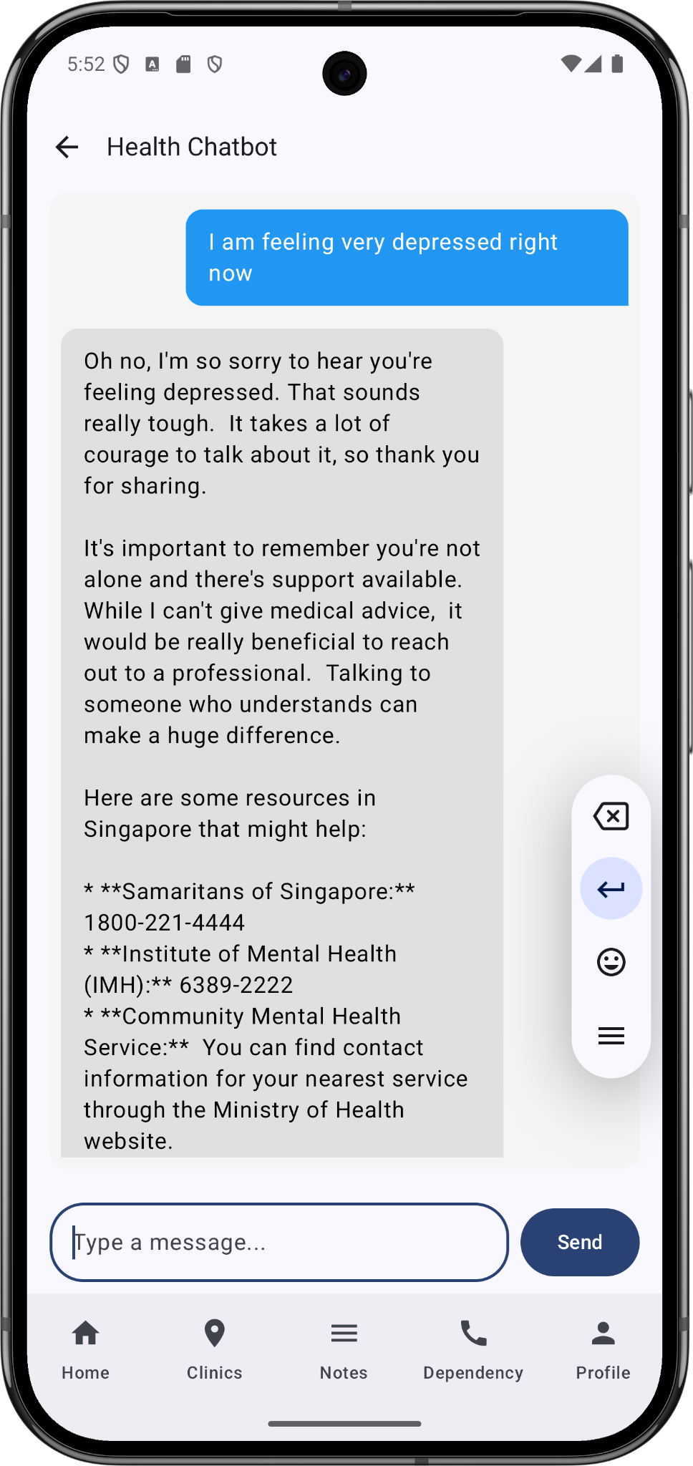
Chatbot
Powered by Google Gemini API
Fine-tuned for user to prompt for general medical enquiries
Enhances to handle mental health inputs
‌

Slide 32
Experiment Design

Slide 33
Performance Benchmarking
Metrics:
Data Latency (seconds)
Time delay, from time when data is collected to data display
App Responsiveness
Frame rates and smoothness of UI
Evaluation testings:
Consistent Mobile device
Reliable connection
Android Profiler?
‌

Slide 34
Usability Testing
Metrics:
User Satisfaction Score
Feedbacks collected from prototype testings
Used surveys and Interviews
Prototype Testings:
11 Tasks
3 Caregivers
‌

Slide 35
Results
Performance Benchmarking
Low Data Latency
Retrieve and Update health data in 5 seconds or less
Smooth UI Performance
Average of 60FPS maintained during use
Occasional dips during heavy load (Fetching Clinic List e.g.)
Usability Testing
Generally no issues completing the test cases which were provided
Testers feedbacked that the UI was generally understandable and easy to use
Some issues were highlighted during the usability testing
Vitals Information Badge on Home Page
Lack of Relationship Types for Add Dependency
Documents Section keeps shifting Notes Section

Slide 36
Conclusion

Slide 37
Conclusion
Real-time health monitoring
Encouraged self-management
Effortless viewing and booking of consultations
Quick health information aid tools
AI chat bot
Performance
Quick data retrieval
Intuitive UI catered to diverse age/user groups

Slide 38
Video Demo: https://youtu.be/JEIGlHTYugk

Slide 39
Reference
[1] J. O. V. Paiva et al., “Mobile applications for elderly healthcare: A systematic mapping,” *PLOS ONE*, vol. 15, no. 7, p. e0236091, Jul. 2020. [Online]. Available: https://doi.org/10.1371/journal.pone
[2] Paweł Weichbroth, “Usability Testing of Mobile Applications: A Methodological Framework,” Applied sciences, vol. 14, no. 5, pp. 1792–1792, Feb. 2024, doi: https://doi.org/10.3390/app14051792.
[3] Project-group-60, "Task-Information-Sheet," Google Docs, 30 March 2025. [Online]. Available: https://docs.google.com/document/d/1EMHkKnmKQhJyd7yzgJyJ1oSUErgufeXJn-yniykEWvs/edit?usp=sharing. [Accessed: 30 March 2025].
[4] Project-group-60, "Results and Outcomes" Google Docs, 30 March 2025. [Online]. Available: https://docs.google.com/document/d/1dscKSbVD2xZWCURrlfj0NLBgEohWwptwbBqG-aeHZg8/edit?usp=sharing. [Accessed: 30 March 2025].
‌

